Slide 1
ENERGY FORECAST
Suresh Gangumalla
B00789128
Data Engineer
Karthick Parameswaran
B0079224
Data Scientist

Slide 2
Introduction:
Importance of Electricity.
Power generation and Storage.
Costs involved.
Shortage and other logistics.

Slide 3
Objective:
Analyze the energy and weather datasets.
Co-relating energy consumption with weather attributes.
Power demand forecasting for Toronto region.

Slide 4
Factors involved:
Weather – Temperature, Humidity
Energy Resources – Wind, Solar, Thermal, Nuclear, Hydro
Time – Day vs Night
Industries

Slide 5
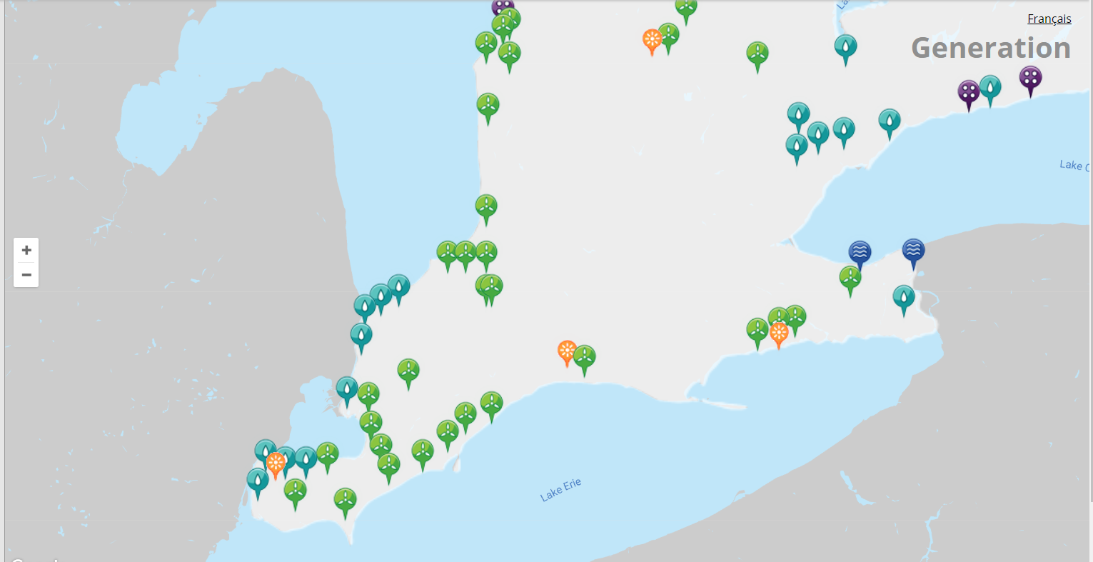
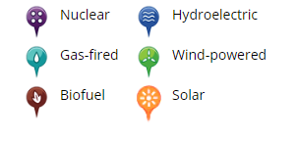
Data Chosen:
Toronto

Slide 6
Technologies & Tools used:
Python
Tableau

Slide 7
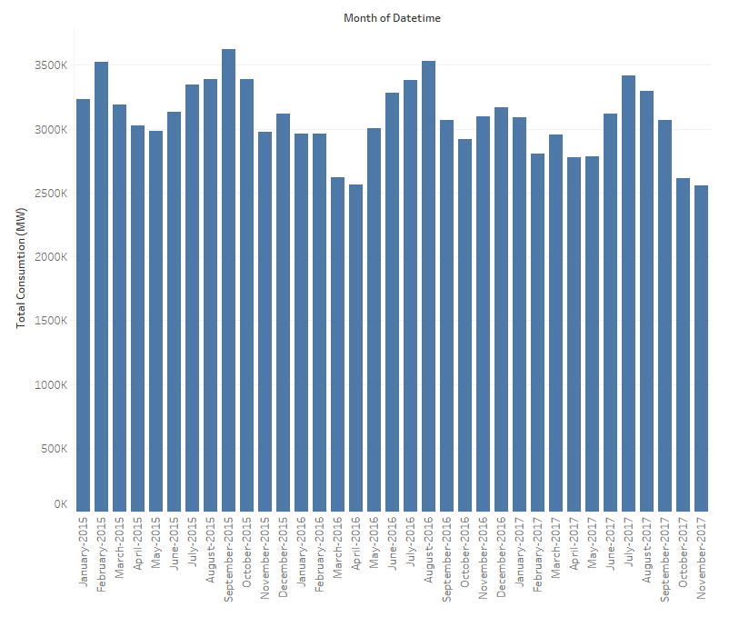
Electricity Consumption (Toronto):

Slide 8
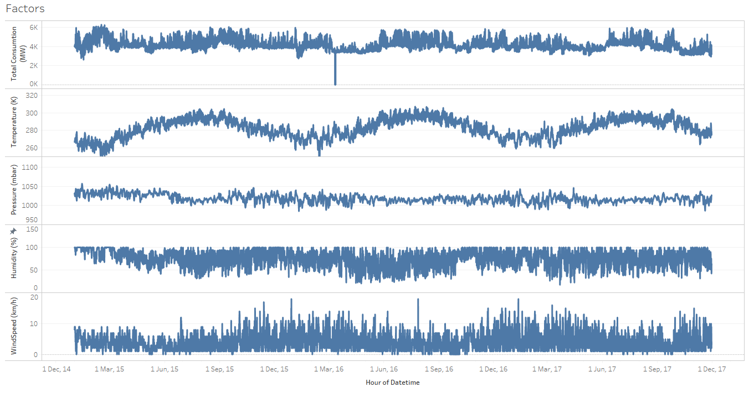
Power Consumption vs Weather Attributes

Slide 9
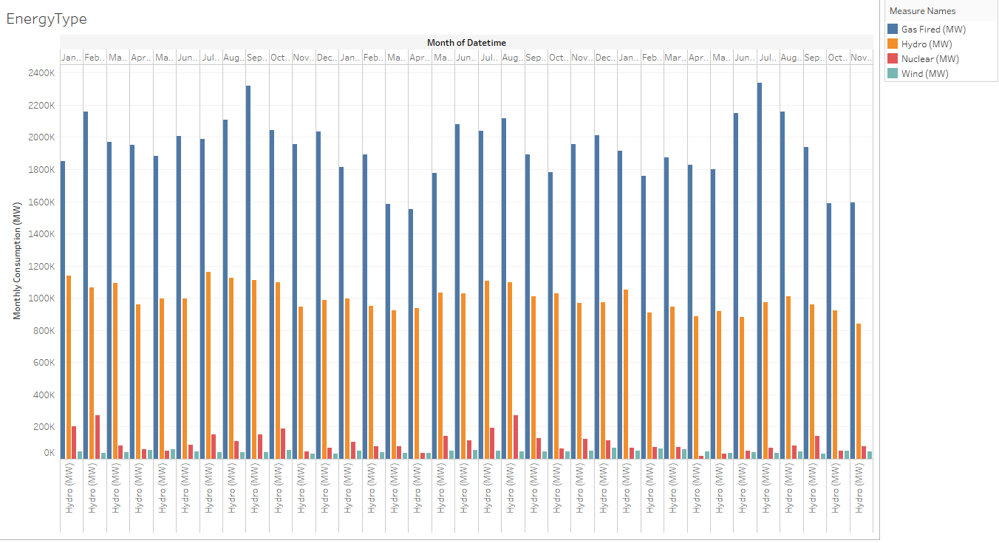
Modes of Electricity produced:

Slide 10
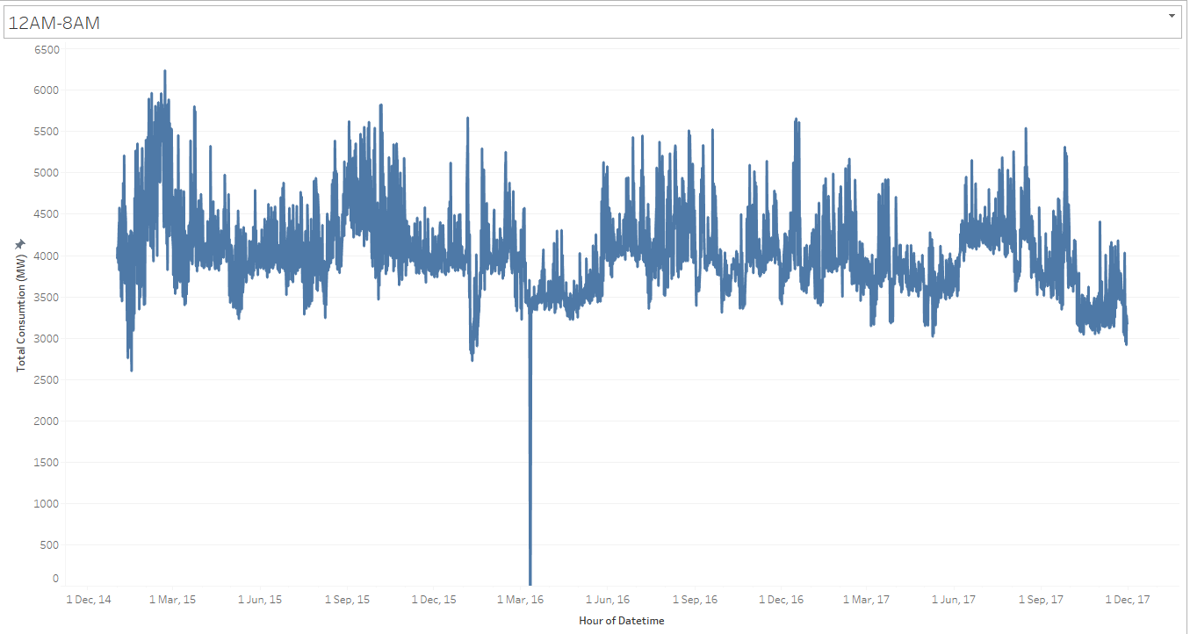
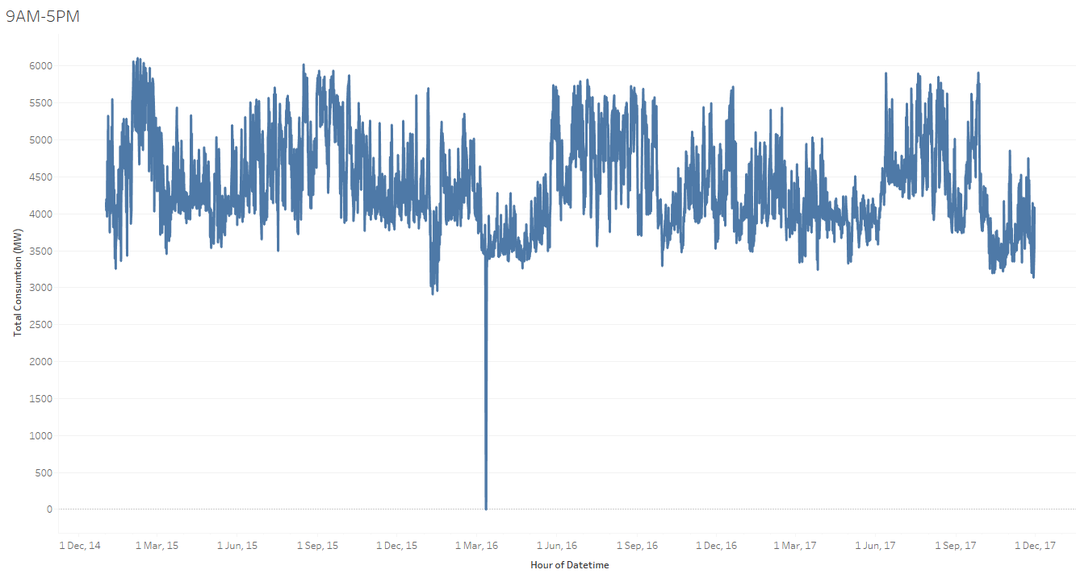
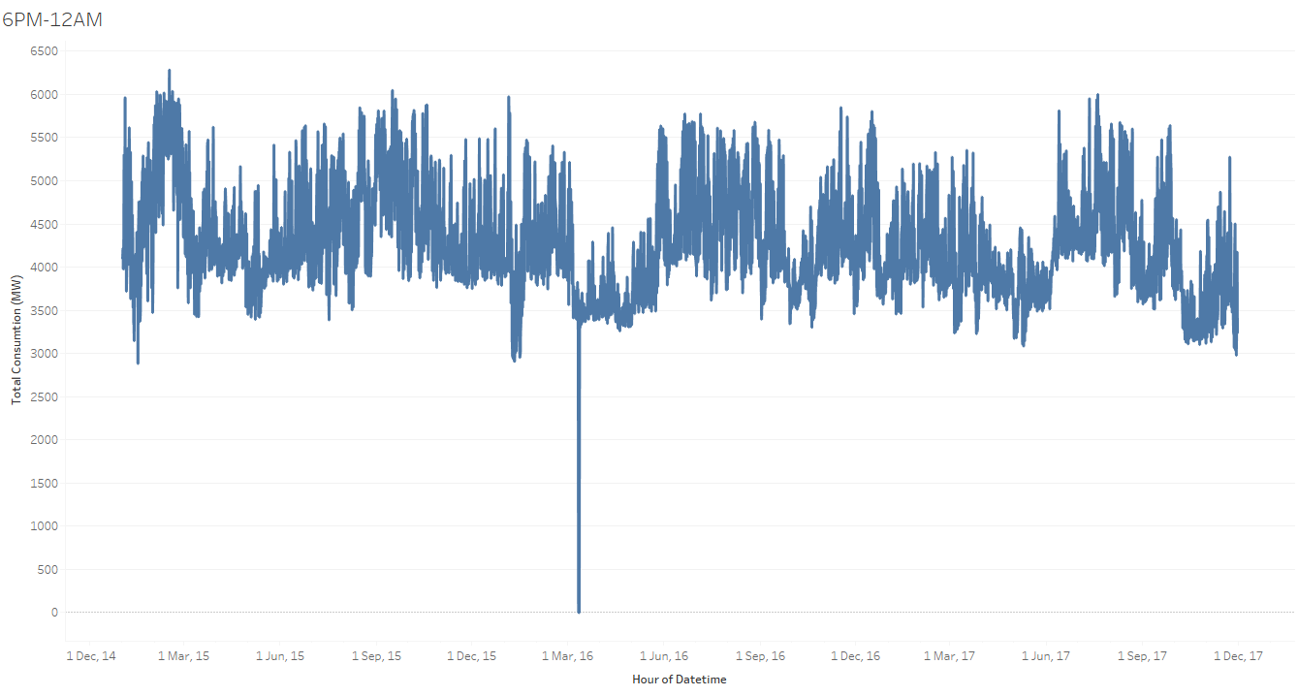
Time as a factor:

Slide 11
Predictions:
IESO and Kaggle dataset for prediction
Variable relations between target and multiple features.
Target – Average total power demand per hour for Toronto.
Features – Temperature, Pressure and Humidity
Outliers:
Holidays
Natural calamities

Slide 12
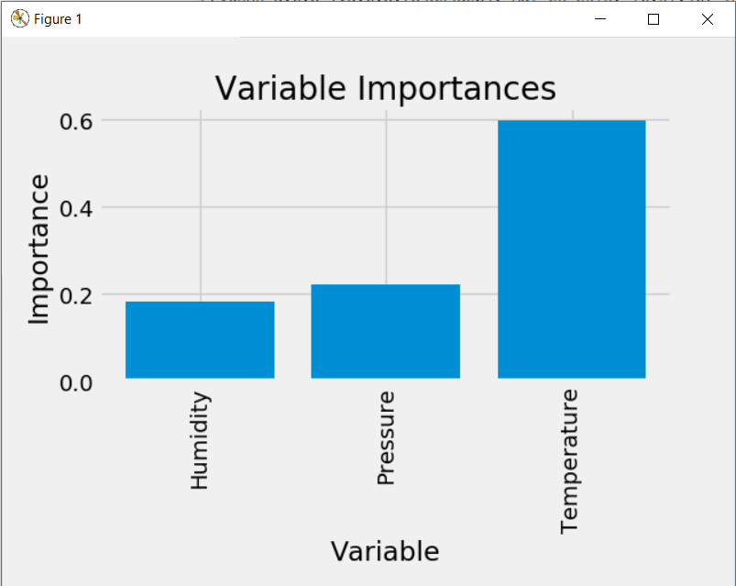
Variable Dependency Analysis:

Slide 13
Algorithms used:
Naïve Bayes
Artificial Neural Networks
Random Forest
Libraries:
Python – Pandas, NumPy, Scikit, MatPlot

Slide 14
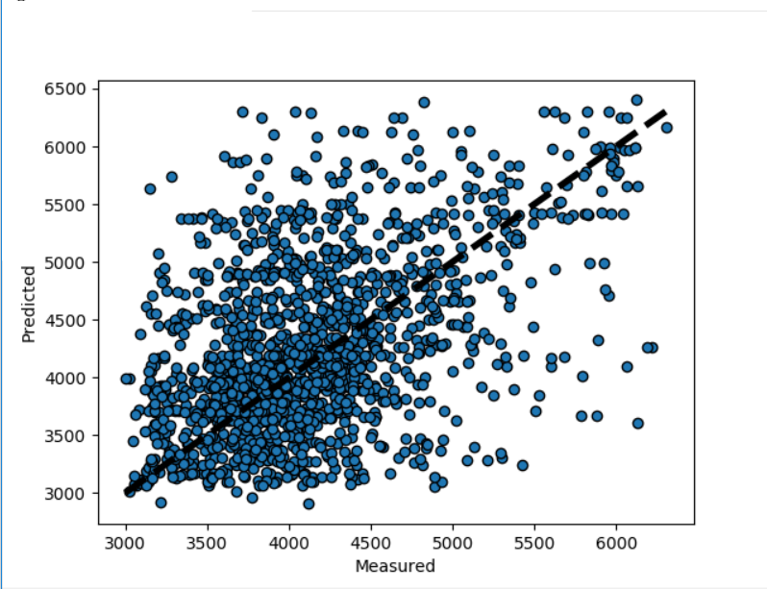
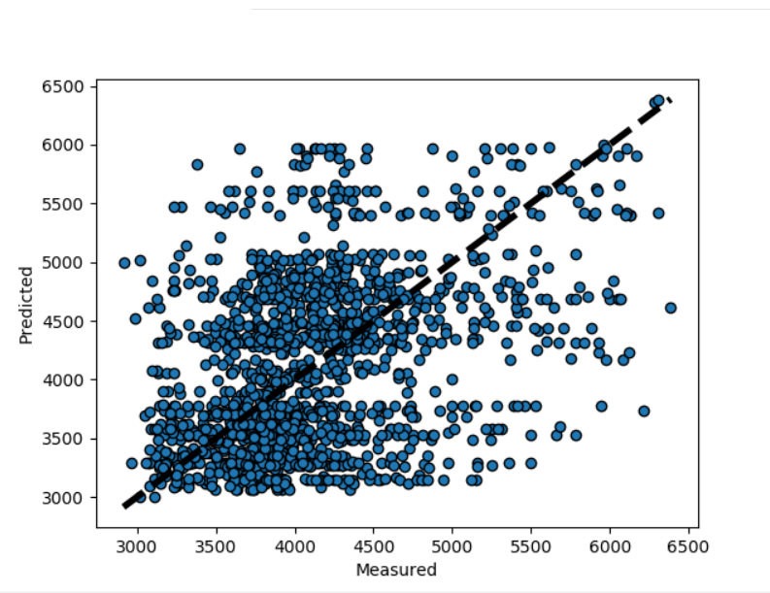
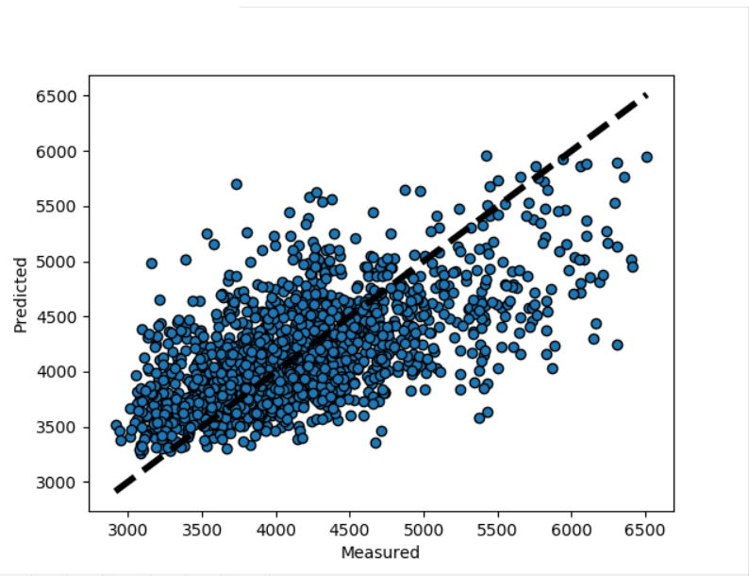
Accuracy Comparison:
Artificial Neural Networks(78%) Naïve Bayes (82%) Random Forest (94%)

Slide 15
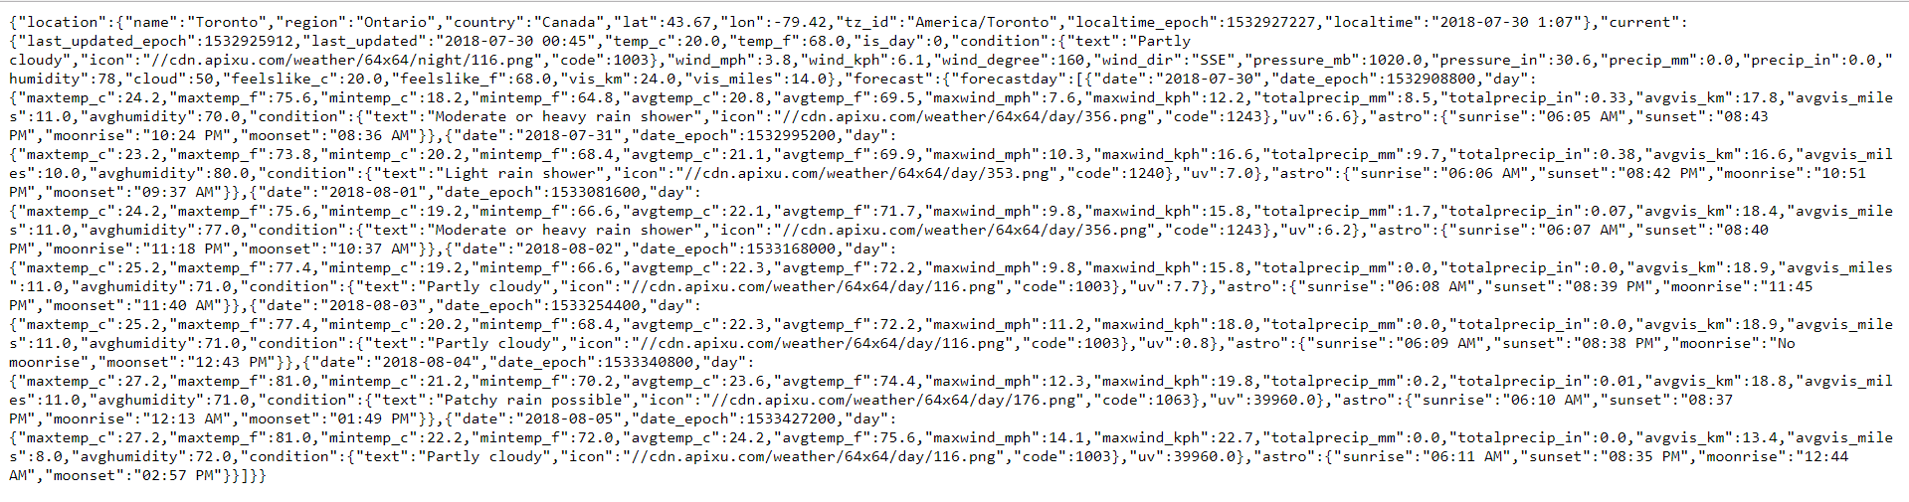
Forecasted Weather data (open weather API):

Slide 16
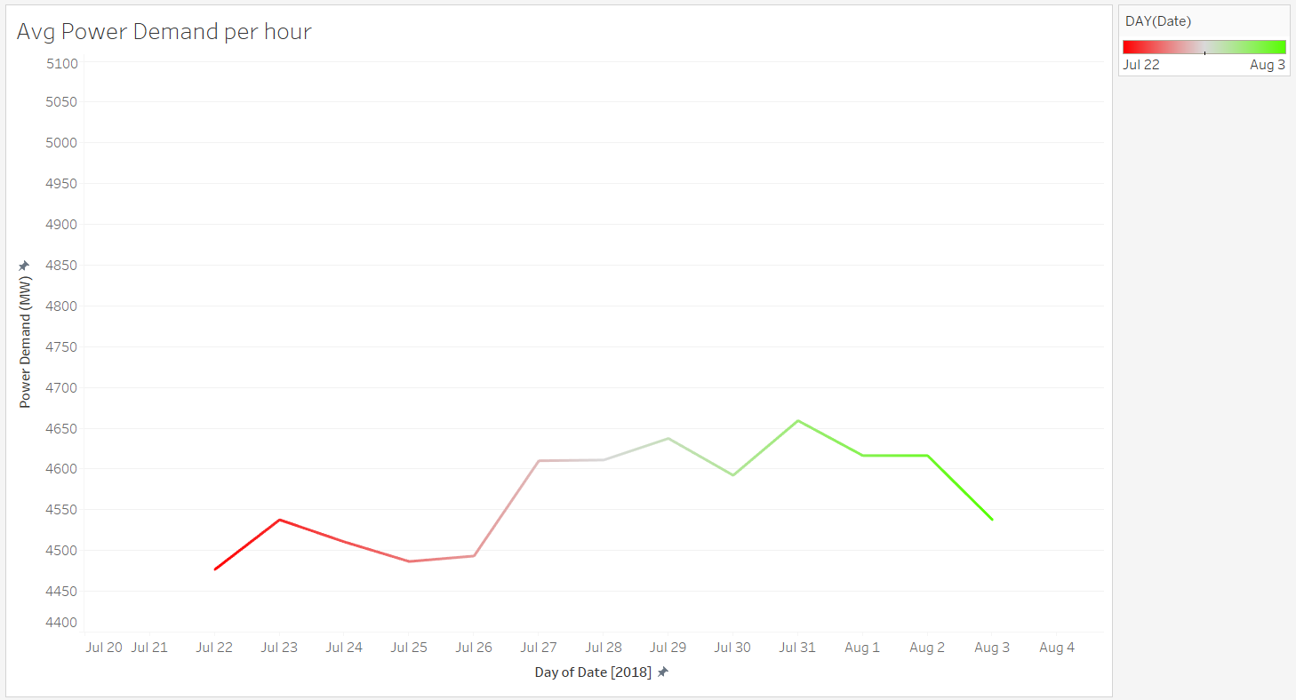
Forecasted Power Demand:

Slide 17
Value Proposition:
Efficient supply-demand power management.
Efficient pre-computed job Scheduling.
Logistics – Raw material, Storage.
Cost Savings.

Slide 18
THANK YOU

